Slide 1
Bike Sharing
WANG JIAHENG
WANG QINGGUO
WU MINGJING
ZHANG YIQUN
ZHOU DUO
Notes:
Hello, professor, the theme of our group is “bike sharing demand prediction”, and my name is Qingguo. my part is introduction of the project.

Slide 2
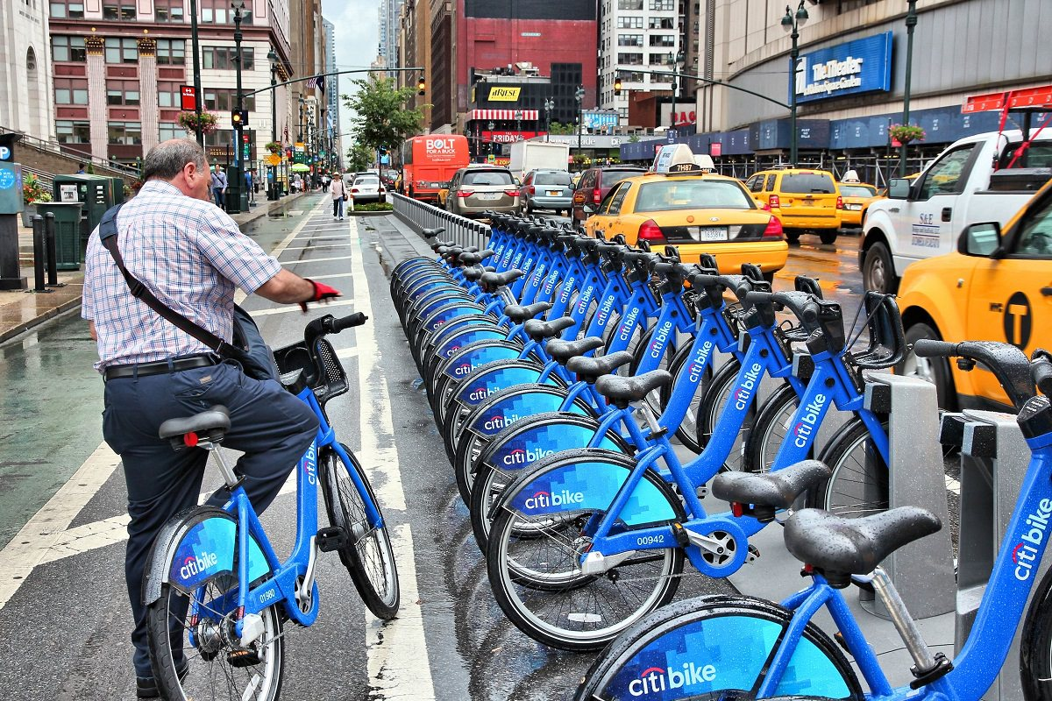
Bike Sharing System
Bike sharing systems are means of renting bicycles, and bike return is automated via a network of locations throughout a city. Using these systems, people are able to rent a bike from a one location and return it to a different place as they needed.
Currently, there are over 500 bike-sharing programs around the world.
Notes:
The bike sharing systems are very popular these years. And currently, there are over 500 bike-sharing programs around the world.Using these systems, people are able to rent a bike from one location and return it to different places as they needed.

Slide 3
Problem statement
The data generated by the systems makes them attractive for researchers because the duration of travel, departure location, arrival location, and time elapsed is explicitly recorded. Bike sharing systems function as a sensor network, which can be used for studying mobility in a city.
In this project, we try to combine historical usage patterns with weather data in order to forecast bike rental demand in the Capital Bikeshare program in Washington, D.C.
Notes:
In this project, we try to combine historical usage patterns with weather data in order to forecast bike rental demand in the Capital Bikeshare program in Washington, D.C.

Slide 4
Data description
9 features in total (we combine the registered and casual as total)
5 categorical: datetime, season, holiday, working day, weather
4 continuous: temp, atemp("feels like" temperature in Celsius), humidity, windspeed
10886 data records in the training dataset
6493 data records in the test dataset
Both train file and test test file are complete in which requires no imputation process.
Notes:
There are 9 features in total, including 5 categorical features which are datetime, season, holiday, working day and weather and 4 continuous features which are temp, atemp which means feels like temperature in Celsius , humidity and windspeed . And there are around 11 thousand data records in the training file, 6 thousand data records in the test file.
Both train file and test file are complete in which requires no imputation process.

Slide 5
Feature engineering
Month
Day
Year
Hour
Notes:
First we will split the original datetime variable into 4 different variables, month, day, year, hour. But after checking the train and test set, which is already split. We cannot use the day to fit the model because the day of train set is from 1 to 20, and the day of test set is from 21 to 31.

Slide 6
Feature engineering
Dealing with 0 in variable windspeed. (RF model)
Notes:
windColumns = ["season","weather","humidity","month","temp","year","atemp","hour","woy"]
Another interesting thing is that there are a lot of zeros of the windspeed, which also make this variable’s change over time not smooth. So we will consider them missing value and try to fit a random forest model to predict new values to replace them. And the change over time would be smooth. And the variables we use to fit is ……

Slide 7
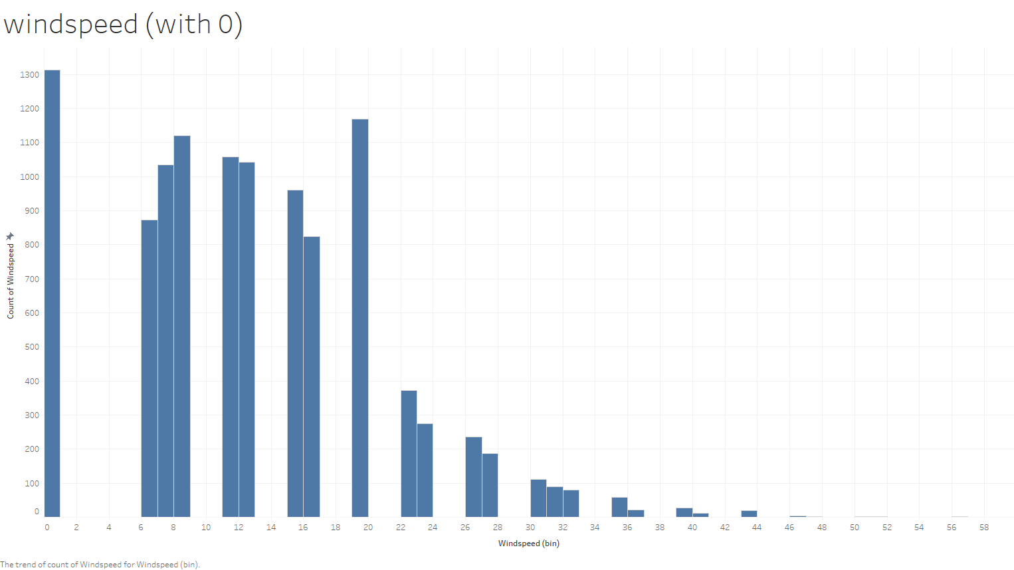
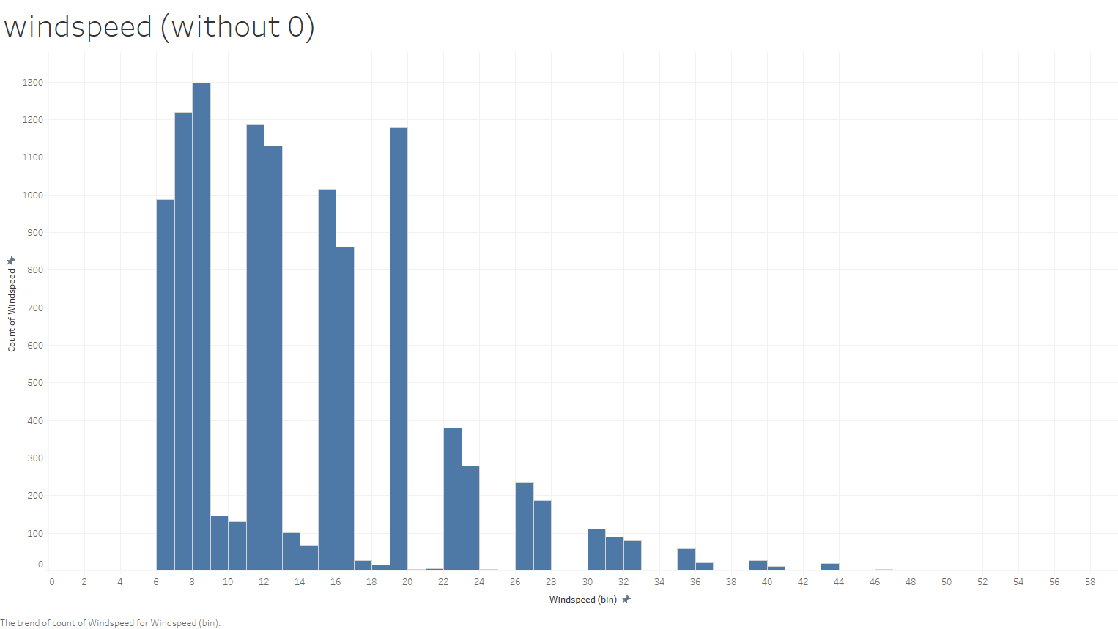
Feature engineering
Dealing with 0 in variable windspeed. (RF model)
Notes:
windColumns = ["season","weather","humidity","month","temp","year","atemp","hour","woy"]
That is the histogram before and after the model prediction, we can see there are a lot of zeros in first one. After fitting, there is no longer zeros and remain the main distribution.

Slide 8
Feature selection
Notes:
Then it is the feature selection part. We are to exclude some highly correlated variable, which can improve the performance of some models. For example. We will exclude these two in the later model fitting part.

Slide 9
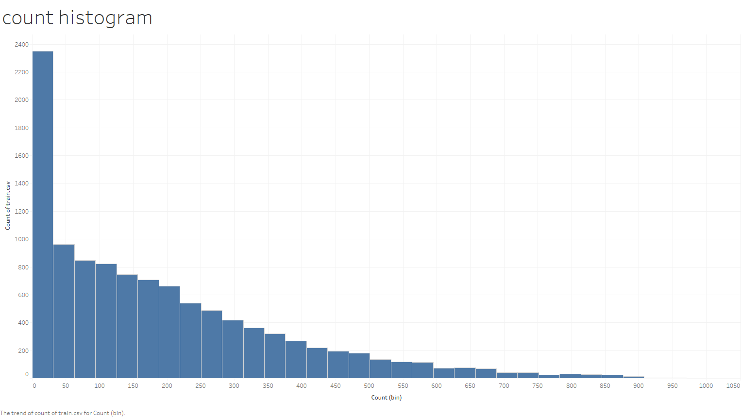
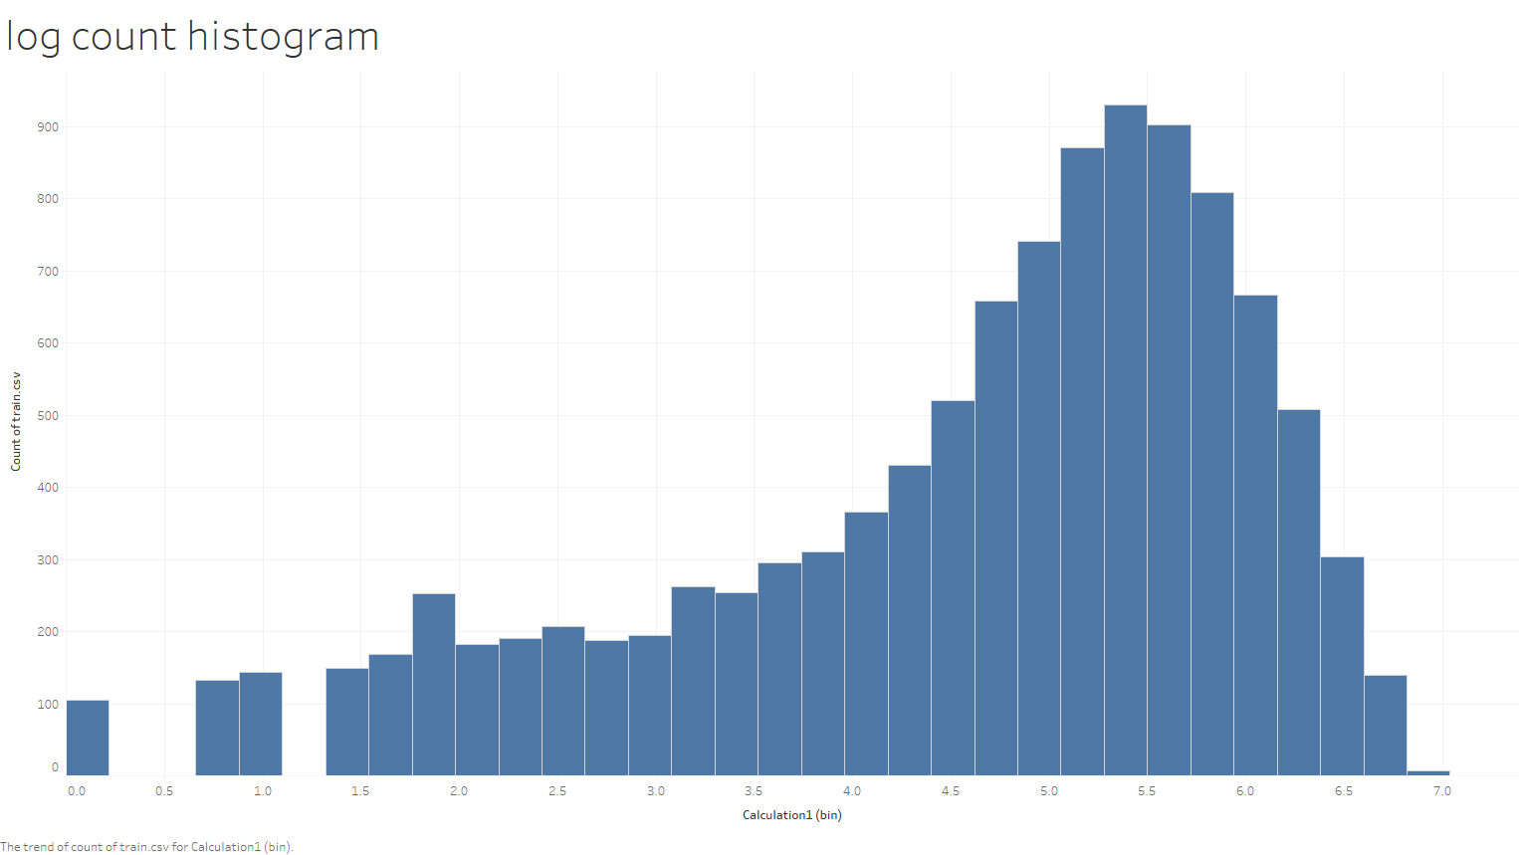
Scaling and Encoding
scaling
encoding
Standardization: make feature distribution centered at 0 and have unit variance. Log Transformation: Try to make the distribution ‘looks normal’.
Just like scaling, it depends on what kind of models we will use to fit the data.
If it is tree-based model, there is no need to apply one-hot encode to process the data.
If the model relies on distance, encoding is needed.
Original season value is 1.
Notes:
We also do some scaling and encoding in order to improve some models’ performance. That all about the preprocessing part.

Slide 10
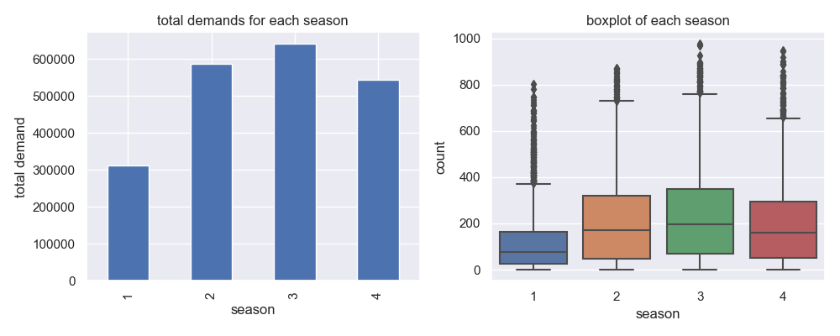
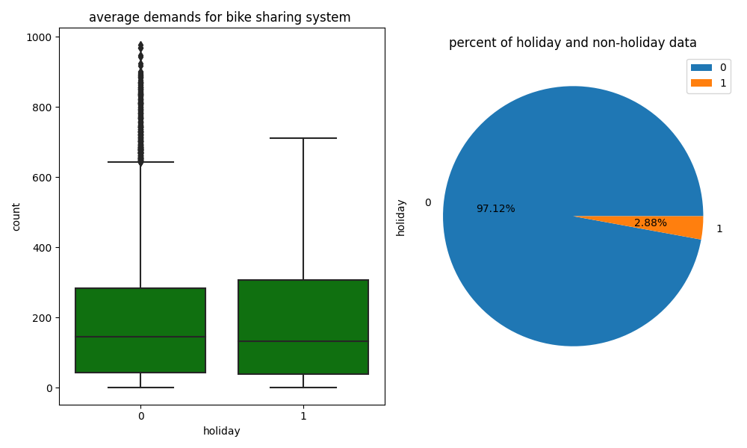
Features Analysis - Holiday Analysis and Season Analysis
From the left, we could draw the conclusion that, from spring to fall, the demand keeps rising, and reaches its demand peak in fall.
The box plot shows that there are much more outliers in spring and winter. You sure don't want to get a bike in a cold and snowy day!
Holiday only account for a less than 3% of total population, so this feature is not good feature to select.
Holiday and non-holiday demands is a little bit different, but it is acceptable to use just the non-holiday data, because of the data size of holiday.
Notes:
So, let’s talk about the feature analysis, this is the holiday feature analysis and the season feature analysis

Slide 11
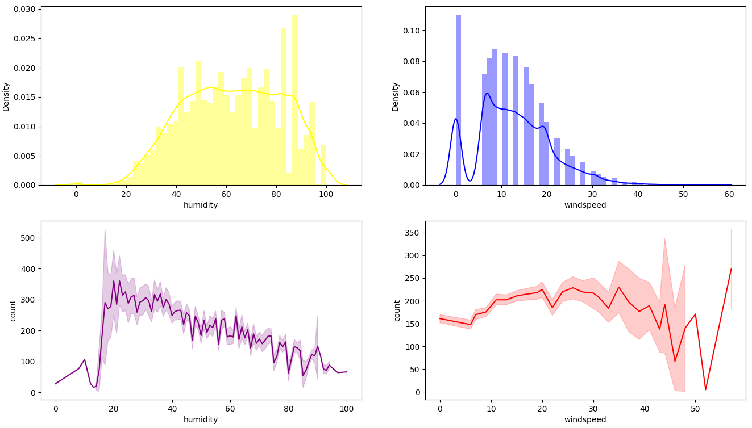
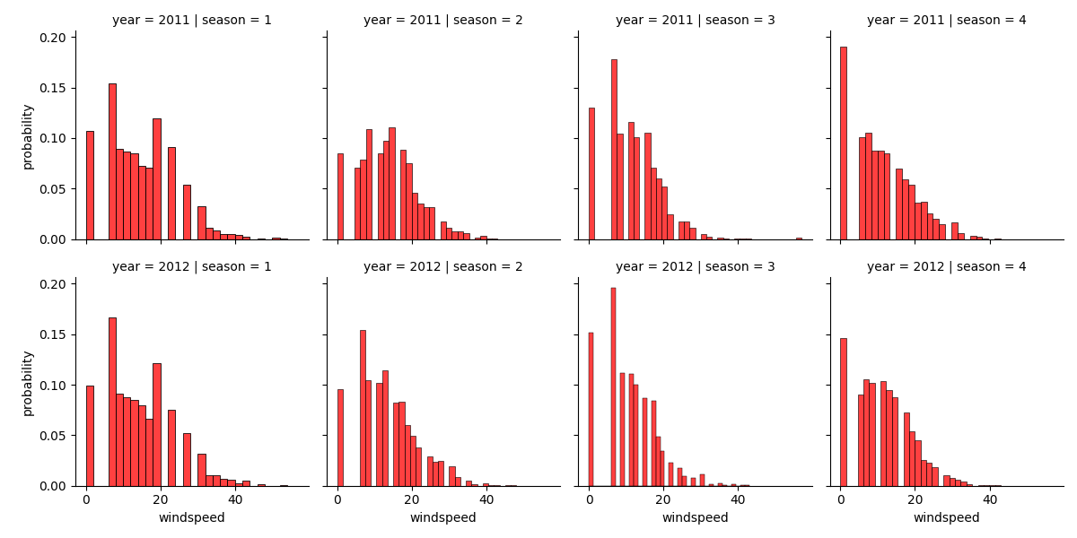
Features Analysis - Humidity Analysis and Windspeed Analysis
Many data are concentrated around 0 in windspeed column, that may indicate that the data collector may fill up the missing value with 0.
Windspeed's distribution in different seasons are almost the same. Which means windspeed column have no missing value.
Notes:
This is the humidity feature analysis and the Windspeed Analysis

Slide 12
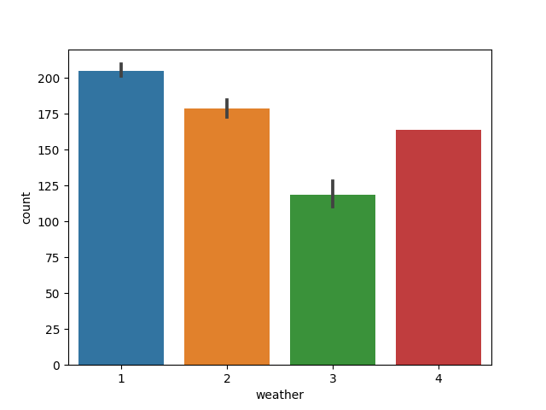
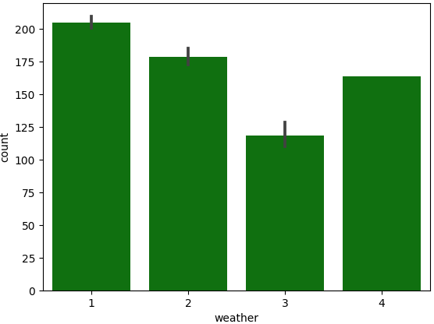
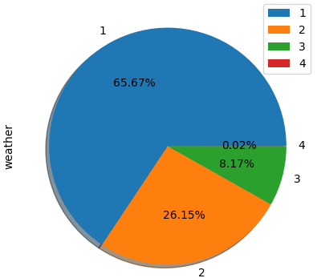
Features Analysis - Weather Analysis
We find out that the worst weather occurred just 3 times, less than 0.01%. That means that we still could say that the worse the weather condition we have, the less demand we need.
Interesting Point! As the rule, the worse the weather, the lower the demand for orders, but in the worst weather(category 4), the demand reversed
Notes:
And this is the weather feature analysis

Slide 13
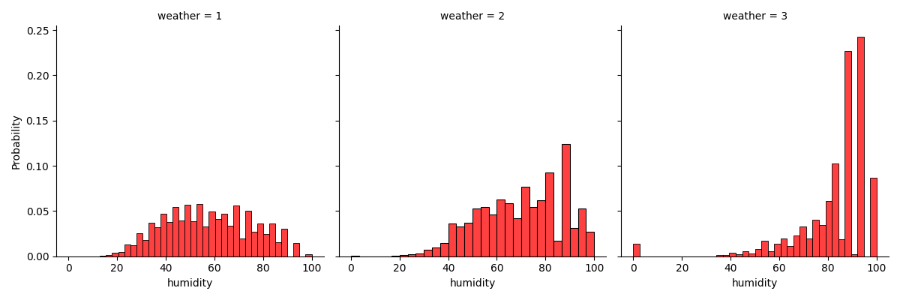
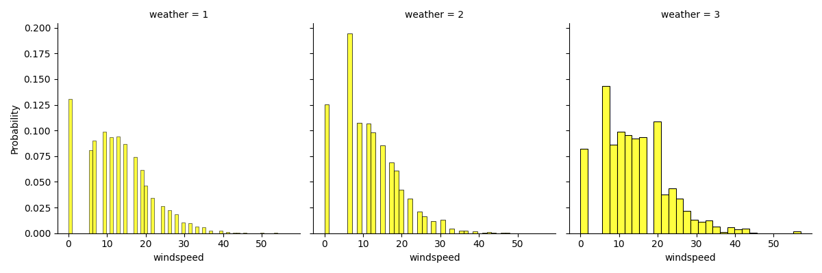
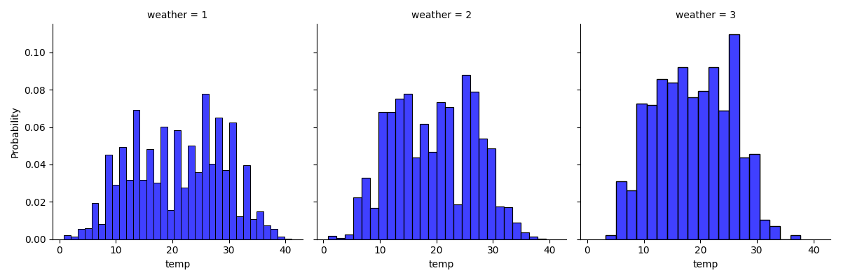
Features Analysis - Weather Analysis
The worse the weather, the higher the humidity. We can deduce that the bad weather always accompanied by rain or snow, and this will lead to higher humidity.
good weather condition implies a smaller windspeed.
The distribution of temperature is largely close to normal distribution for all weather conditions.

Slide 14
Model
The model based on the decision tree algorithm can solve the regression problem well. Therefore, we decide to deploy decision tree model and use boosting and bagging algorithm to improve it. At the same time, we also adopt some classic models such as neural network(MLP) and KNN to solve the regression problem.
KNN
Neural network
Random forest
Bagging(Bootstrap Aggregation)
CatBoosting
Classical models
Tree-based model
Notes:
About our model

Slide 15
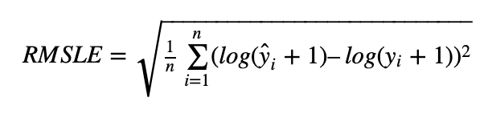
Evaluation metric
Evaluation metric
Our model result are evaluated on the Root Mean Squared Logarithmic Error RMSLE. The RMSLE is calculated as
RMSLE penalizes under-prediction greater than over-prediction, and is suitable for certain scenarios where under-prediction requires greater losses, such as forecasting the demand for sharing bike.

Slide 16
Result comparison
Bagging > Boosting!
One-hot vs. label-encoding
Finding in KNN
Notes:
In this section, the result comparison are shown in the picture. Among all the regressors, we are surprised by the fact that random forest model is the best. The reason why bagging is better than boosting is that in this relatively simple case, boosting result in an over-fitting problem by adapting more complex model while bagging may solve over-fitting problem.
Finally, we reach to a interesting finding. We have learned that there is no need to do scaling and one-hot encoding before training the tree-based model and neural network request to get this two prepossessing before training. However, KNN is also sensitive to this two operation. And u can see KNN is better with one-hot simply because it is more easy for it to calculate distance through one-hot encoding.

Slide 17
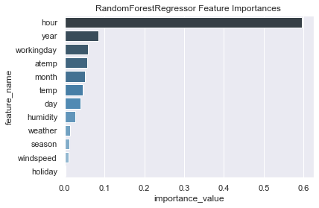
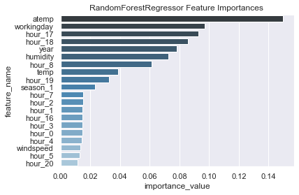
Feature importance
Notes:
These two pictures show the importance of the random forest model. Left hand side shows the feature without one-hot encoding while right hand side shows feature with one-hot.
Both pictures show that we should focus more on time such as (hour, workingday or year), since the demand for sharing bike is strongly correlate with those commuters.
Also atemp and weather do influence on the demand. Let’s see what we have learnt through the whole modeling process.

Slide 18
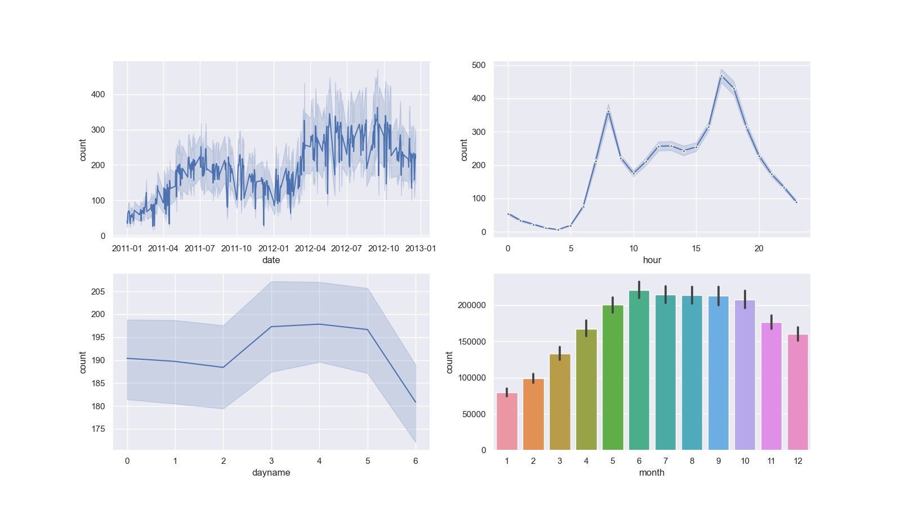
Review
&
Exploration
Notes:
Daily usage keeps raising.
The colder the month, the less people demands a bike. Spring marks the point of which the demand get hiking, the demand reaches its peak on summer, and the demand keeps declining till spring.
From ‘dayname’ columns, we notice some fluctuation.
There are two peaks each day on commuting hour.

Slide 19
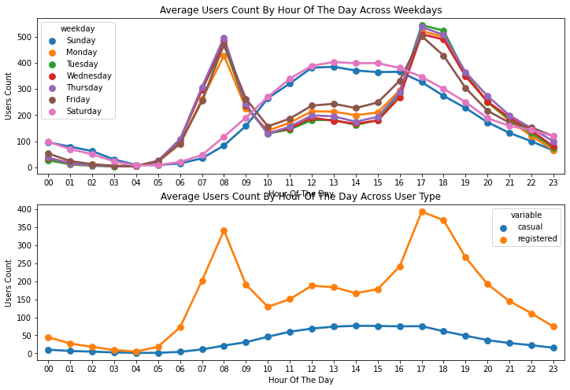
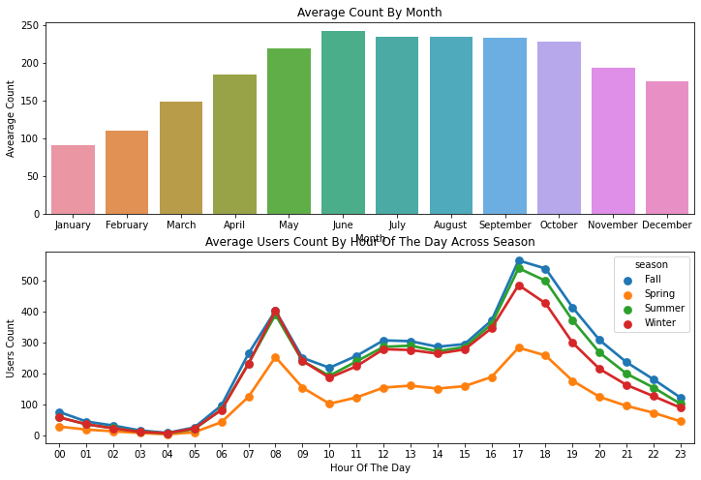
Insights & Conclusion
1. The usage of bicycles in different time periods of the day has the most obvious change. The usage during the morning peak and evening peak hours of workdays has increased significantly, and the changing trend of the use of different periods on weekends and workdays is completely different.
2. Months and seasons have a certain impact on the usage of bicycles, and the influence of seasons is more obvious. It is more in summer and autumn, but less in winter and spring (January and February are the least); It is quite obvious that people tend to rent a bike during the summer season since it is really conducive to riding a bike at that season. Therefore June, July, and August has got relatively higher demand for a bicycle.
Notes:
On weekdays more people tend to rent bicycles around 7 AM-8 AM and 5 PM-6 PM. As we mentioned earlier this can be attributed to regular school and office commuters. The above pattern is not observed on "Saturday" and "Sunday". More people tend to rent bicycles between 10 AM and 4 PM.

Slide 20
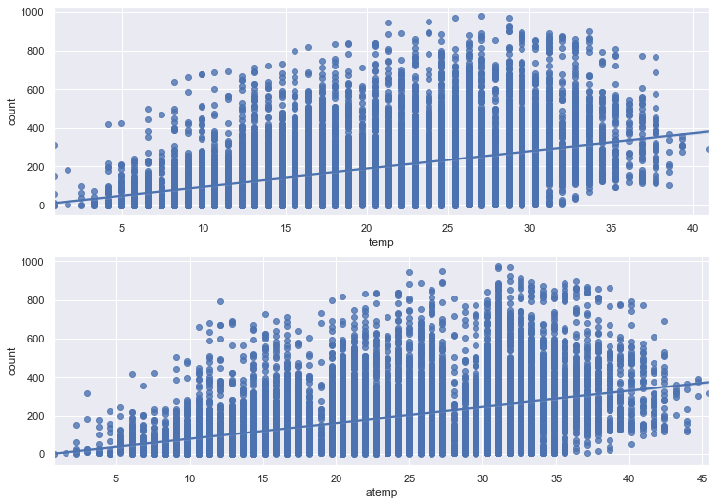
3. Severe weather (heavy rain, heavy snow, hail) will reduce the use of bicycles, and the impact of other weather is not obvious; When the body temperature is lower than 10 degrees, the amount of bicycle usage is obviously reduced, and the influence of other temperature ranges on the amount of bicycle usage is not obvious;
4. In addition, registered users contribute most of the usage, and the changing trend at different times of the day is consistent with the changing trend of the total usage. There is no obvious trend in the usage of non-registered users at different times of the day. The peak user count around 7 AM-8 AM and 5 PM-6 PM are purely contributed by the registered users.

